Slide 1


Signing of the Common Strategy
16. september 2026
We bring future occupations closer through experience.
Notes:
Pozdrav gostitelja in pozdravna nagovora
The CDO-VR project is an Interreg project co-financed by the European Regional Development Fund.

Slide 2




02
STARTING POINT
Why the project?
Three key challenges that call for a new approach.
?
Staff shortages
Shortage occupations in Slovenia and Austria remain understaffed.
The challenge of youth and the unemployed
Difficulties in choosing a career path and limited insight into the reality of work.
The need for experiential guidance
Traditional career guidance does not inspire – we need a new experience.

Slide 3
11
RESULTS
Achievements in numbers
More than 1,900 participants. GZS Silver Innovation Award.
53
838
300+
3
trained professionals
students involved in creative SI-AT presentations
unemployed people involved in creative SI-AT presentations
CDO-VR Centres
SI and AT

Slide 4
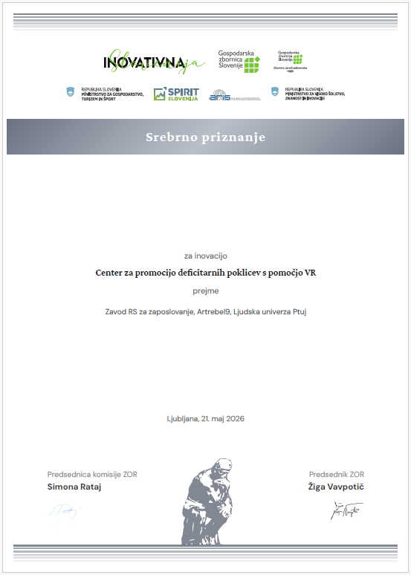
02
ACHIEVEMENTS
What have we achieved?
Concrete project results that speak for themselves.
VR experience for 6 occupations
We developed VR content for 6 shortage occupations. Average rating: 4.4–4.8/5.
Silver Award for Innovation
In May 2026, GZS awarded the CDO-VR innovation a Silver Innovation Award.
Cross-border transfer model
3 CDO-VR Centres, 32 schools, model ready for transfer.

Slide 5



03
JOINT PARTNER STATEMENT
Purpose of the Common Strategy
Commitment to the future. Sustainability of project results.
Career guidance
Informed career decisions
Cross-border cooperation
Further use of VR as an innovative tool for career guidance.
Promoting informed decision-making about educational and career pathways.
Strengthening sustainable SI-AT cooperation on innovative approaches.
Notes:
Nastja

Slide 6
03
JOINT PARTNER STATEMENT
Common Strategy – Key Commitments
Strategy & VR Tool
Sustainability & Transfer
• Centres for Shortage Occupations to continue operating
• Integration into regular work of all partners
• Active pursuit of further funding (Interreg, Erasmus+, ESF)
• Materials and strategy publicly available
• CDO-VR approach transferable to other organisations
• VR as an innovative career guidance tool
• Raising visibility of shortage occupations among youth & unemployed
• Supporting informed career decisions
• VR used as supportive (not selection) element
• Pilot results: ratings 4.4–4.8 / 5
Partners commit to continued use, cross-border cooperation, and alignment of education with labour market needs.
Notes:
SPEAKING NOTES - Joint Partner Statement
This slide summarises our joint partner statement - a shared commitment all partners have signed.
STRATEGY & VR TOOL:
- Together, we developed a joint strategy for continued use of project results.
- At its core is VR as an innovative tool for career guidance and promoting shortage occupations.
- Our goal is to raise the visibility of these occupations - especially among young people and the unemployed.
- VR helps people make more informed career decisions.
- We use VR as a supportive tool in counselling - not for selection.
- Our pilot confirmed this works. Participants rated the VR experience and workshops between 4.4 and 4.8 out of 5.
SUSTAINABILITY & TRANSFER:
- The Centres for Shortage Occupations will continue to operate after the project ends.
- All partners will integrate the approach into their regular activities.
- We will actively seek further funding through Interreg, Erasmus+, ESF, and national calls.
- All materials and the strategy will be publicly available on partner websites.
- The CDO-VR approach is designed to be transferable - other organisations and regions can adopt it.
CLOSING:
- With this statement, we confirm our shared commitment to cross-border cooperation and to better aligning education with labour market needs.

Slide 7
03
INVITATION
Invitation to speak
At the formal project closing and signing of the Joint Partner Statement, we invite you to share a brief thought with us.
Project significance
The value of cooperation
Opportunities and challenges
What does the project mean to you and what impact has it had?
What do you value about our cooperation?
What opportunities and challenges do you see in our continued joint work?

Slide 8
CLOSING
CDO-VR
Shared commitment to the future of career guidance.
Innovation
Accessibility
" We bring career opportunities to
life through experience"
Cooperation
Sustainability
Thank you. We invite you to sign.

